Slide 1

HACKATHON PROJECT
Batch-3

Slide 2
TEAM MEMBERS
Sri Harshitha Gaddamanugu (935048)
Akshaya Vahini Surepally (935099)
Bhaskar Pedda Narsappa (935917)
B Sai Kumar Yadav (935918)
Rajesh Chakali (935720)

Slide 3
ABOUT OUR WORK
Our work is to inspect the website and automate the module. Our purpose is to test the different functionalities of the system. This includes the following functionalities.
1. To display 5 Car washing services name and phone numbers with highest rating on top & with customer votes more than 20 near our location.
2. Registering for Free listing, capturing and displaying error messages when an invalid input is given.
3. Retrieve all the gym sub menu items in a list from the Fitness.

Slide 4
ABOUT THE WEBSITE-JUSTDIAL
The website we used is Justdial (justdial.com)
JustDial is an Indian internet technology company that provides local search for different services in India over the phone, website and mobile apps. It is founded in 1996 by VSS Mani, the company is headquartered in Mumbai, India.
URL : justdial.com

Slide 5
FITNESS SERVICES

Slide 6
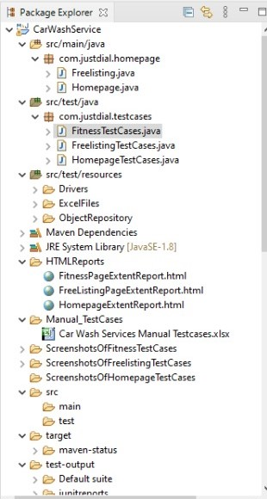
PAGE OBJECT MODEL

Slide 7
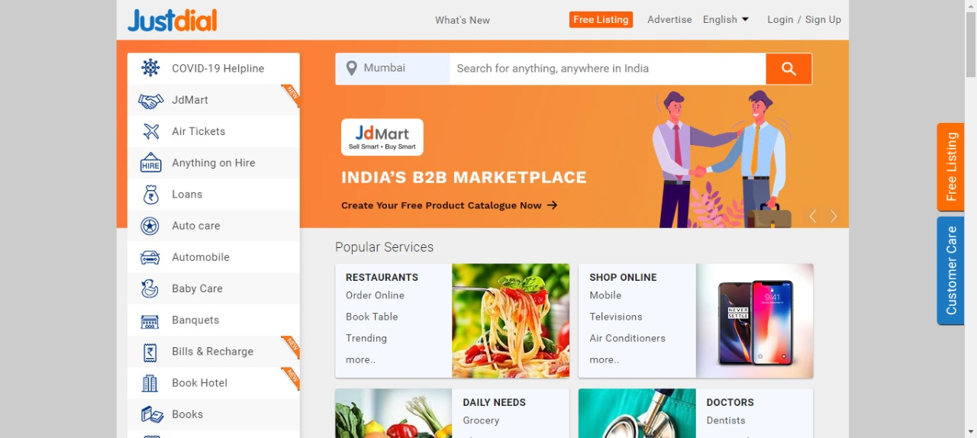

Slide 8
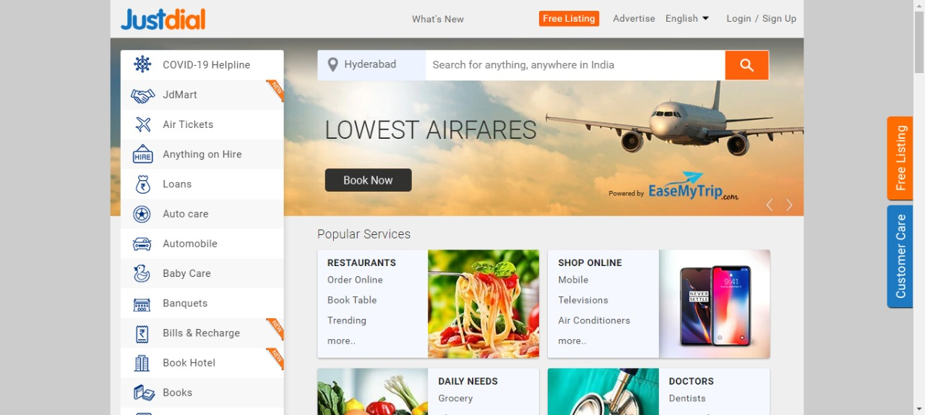

Slide 9
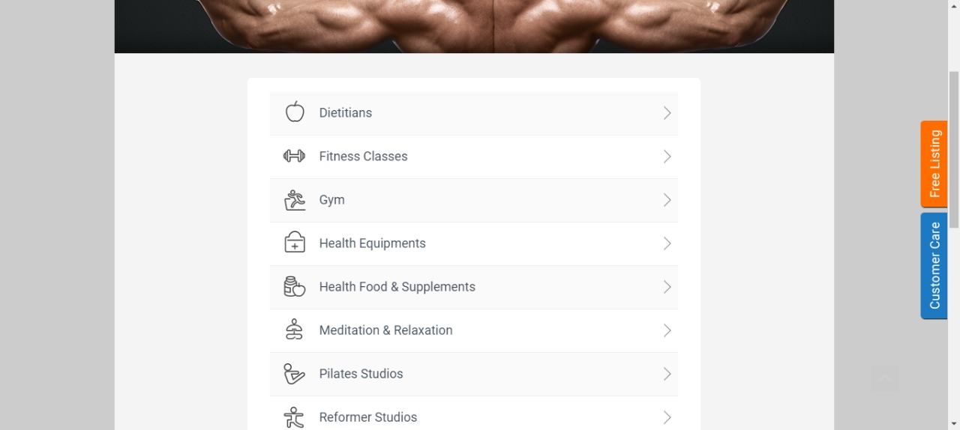
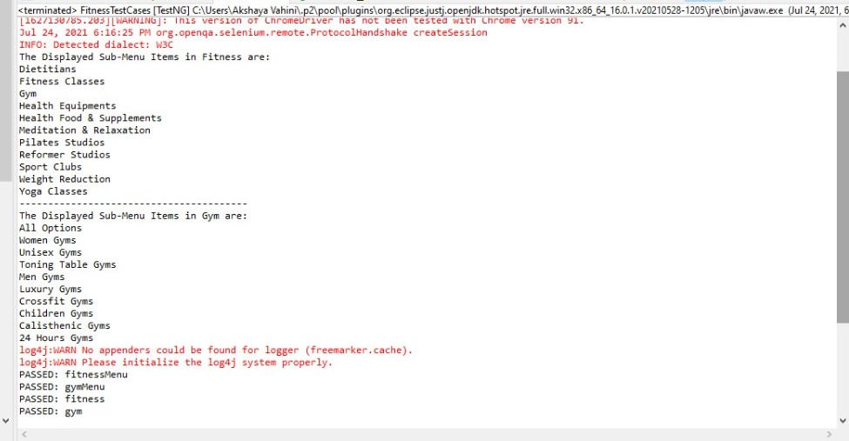

Slide 10
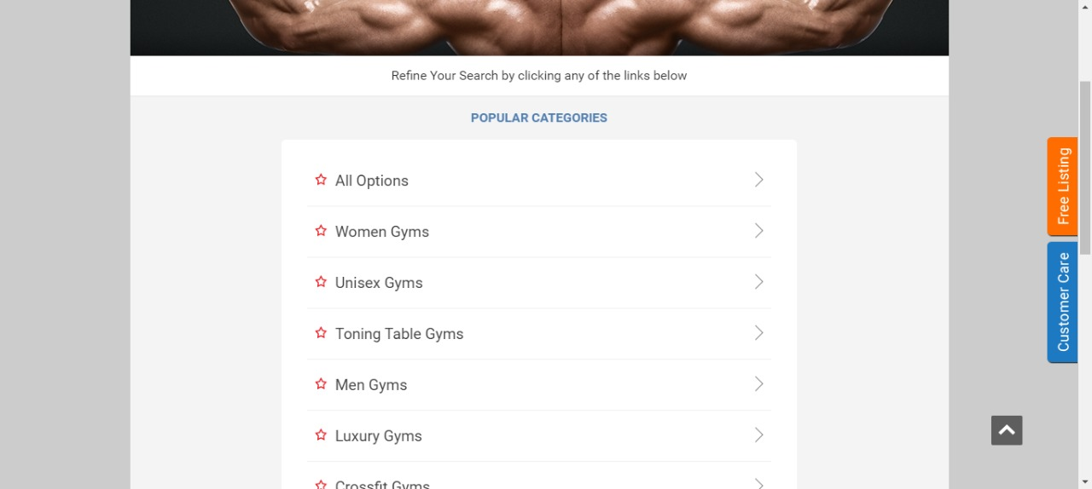

Slide 11
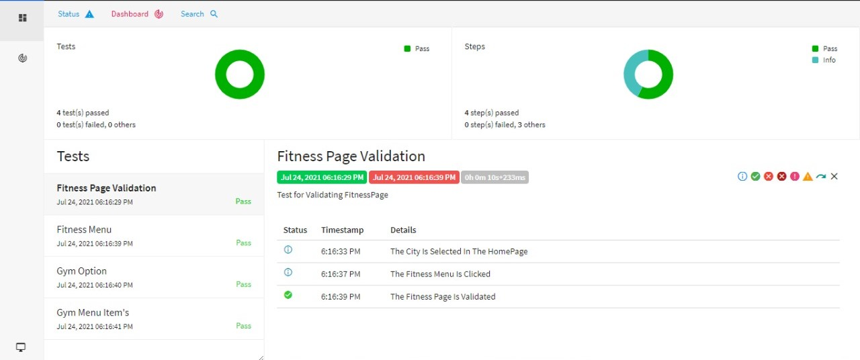

Slide 12
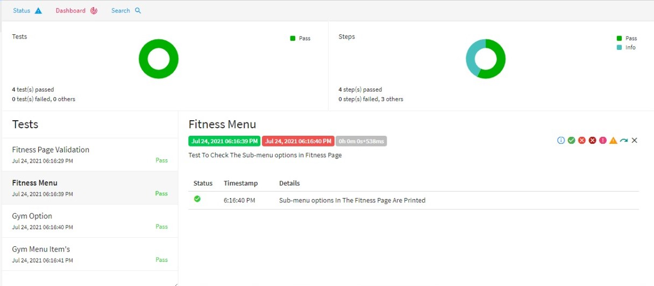

Slide 13
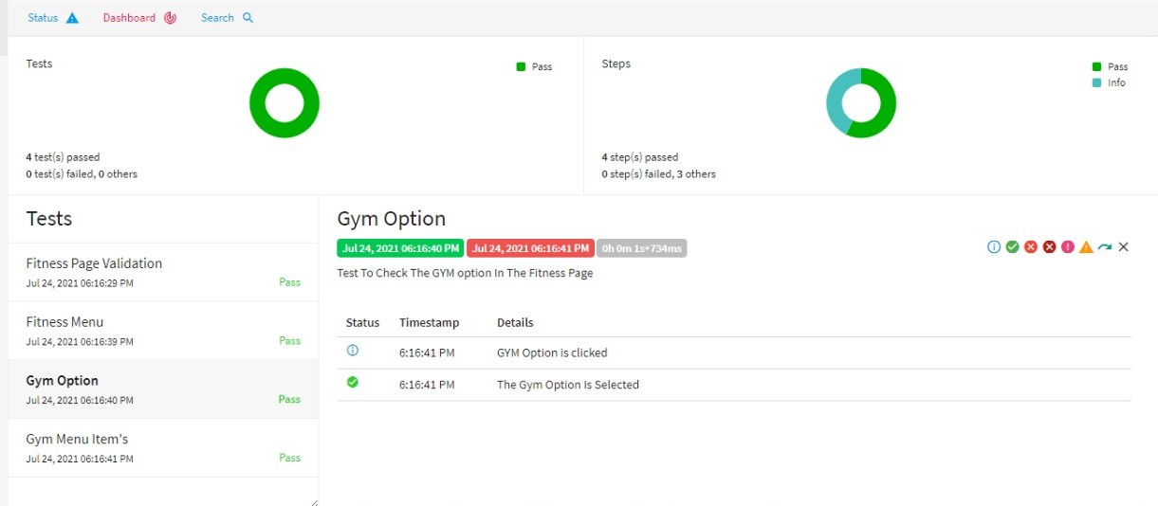

Slide 14
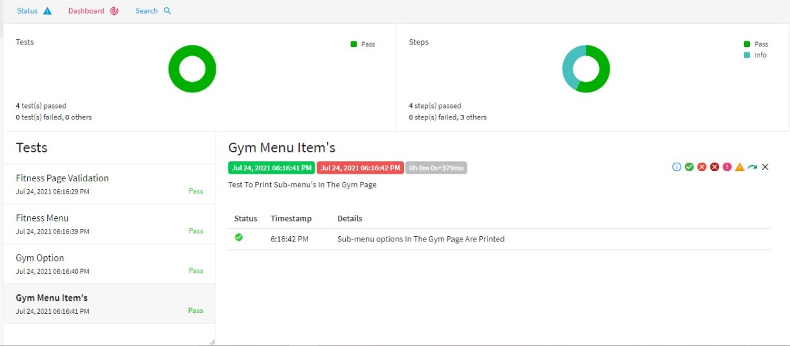

Slide 15
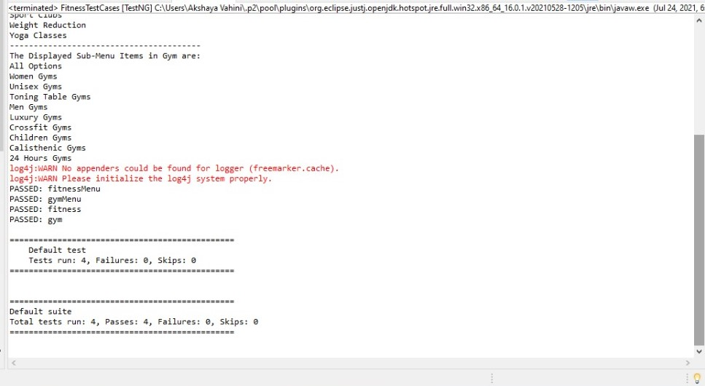

Slide 16
FREE LISTING

Slide 17


Slide 18
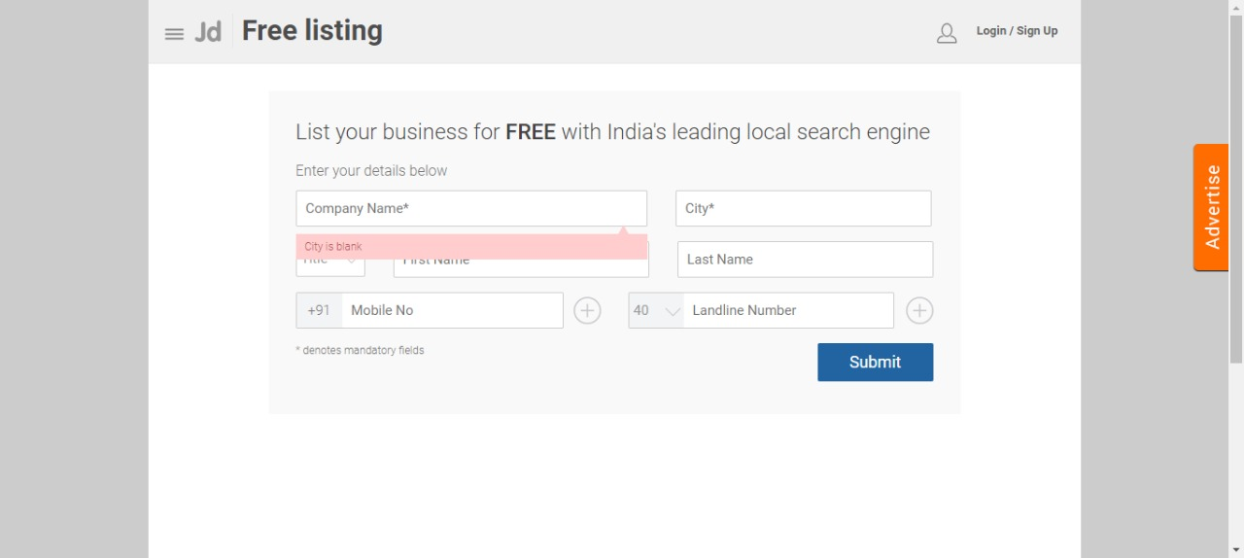
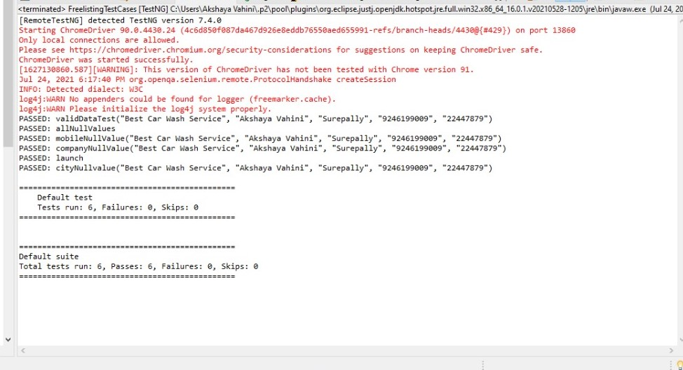

Slide 19


Slide 20
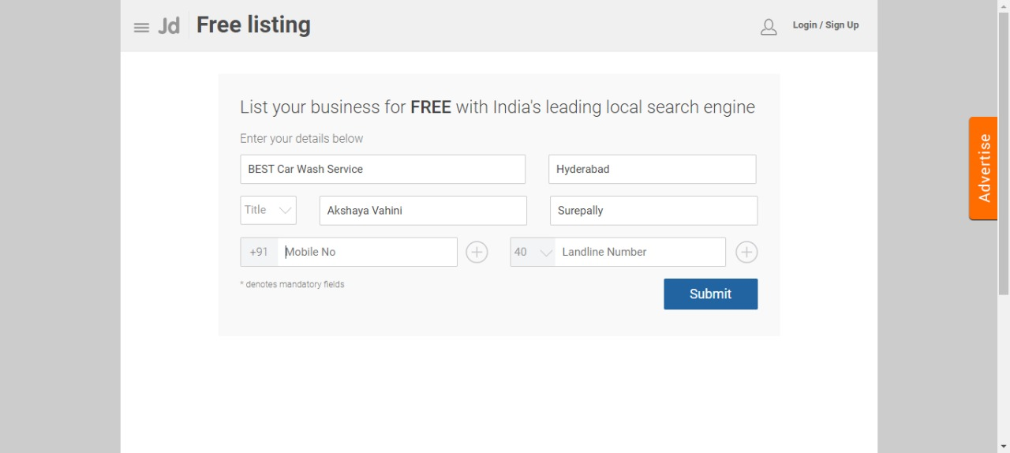

Slide 21
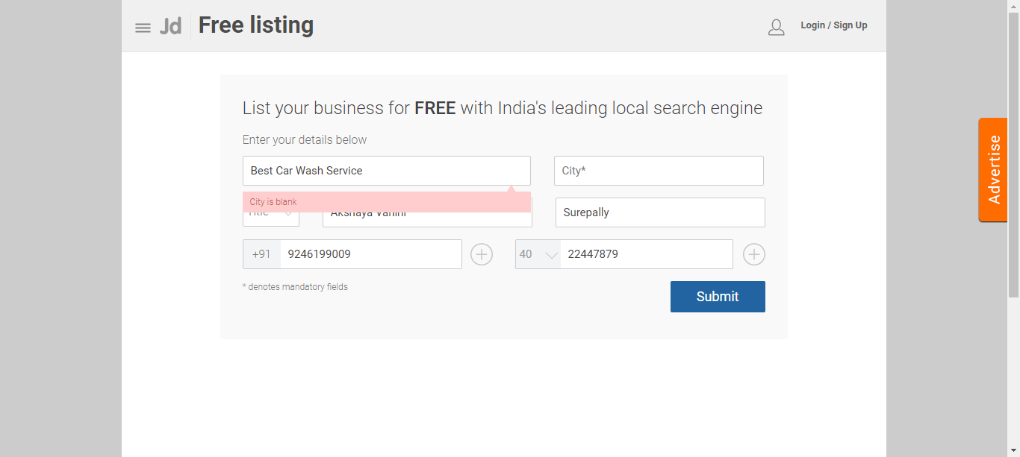

Slide 22


Slide 23
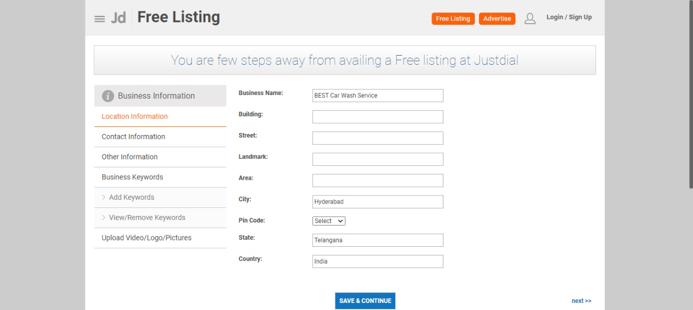

Slide 24
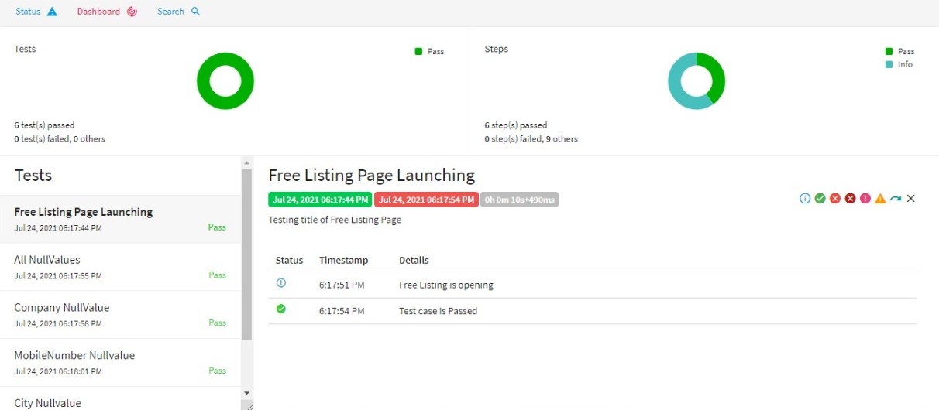

Slide 25
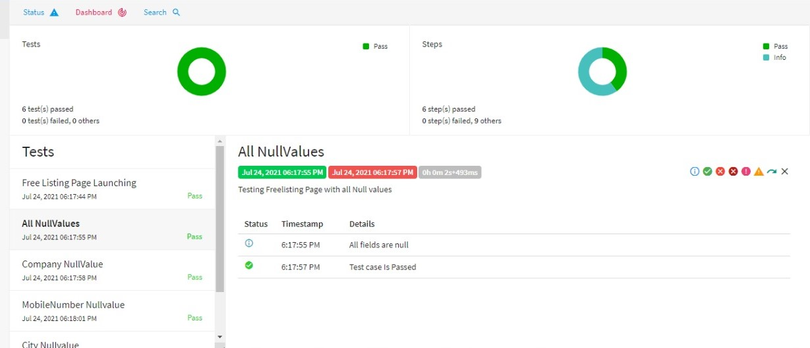

Slide 26
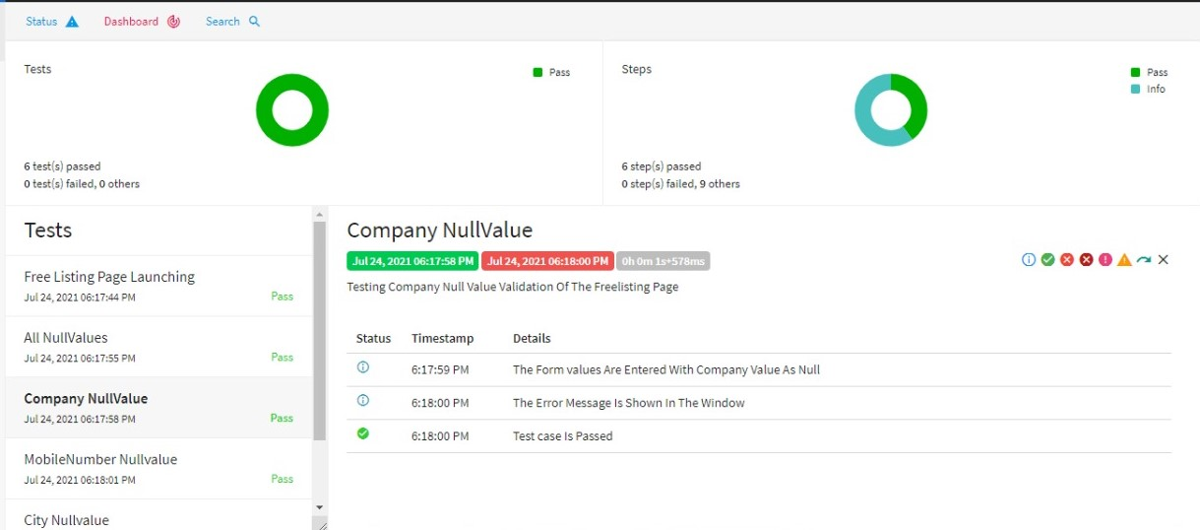

Slide 27
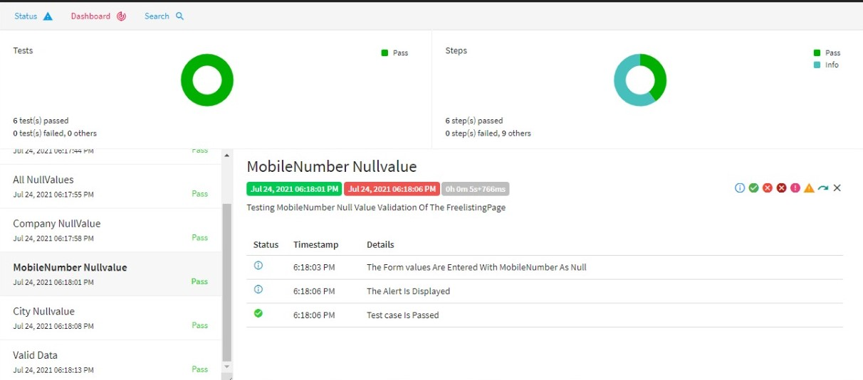

Slide 28
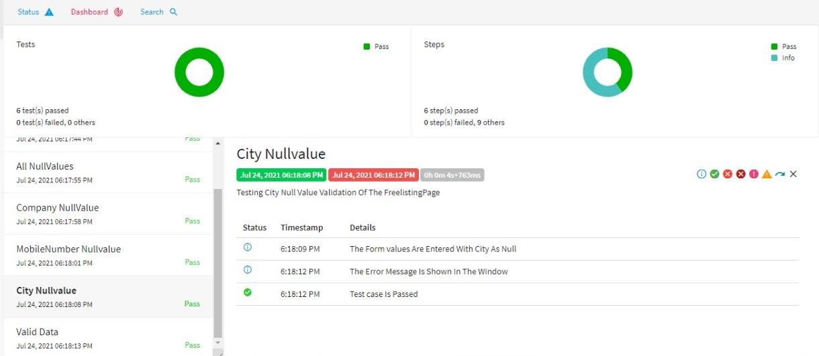

Slide 29
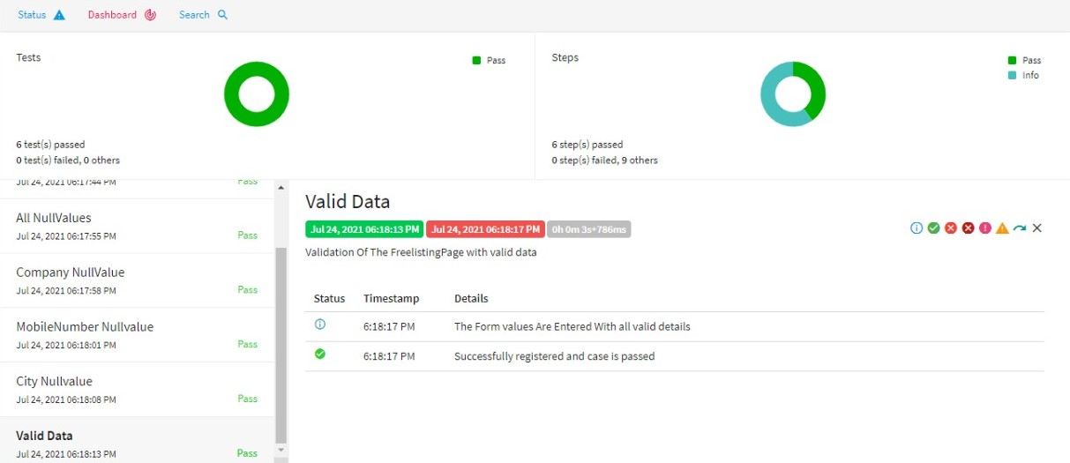

Slide 30
CAR WASH SERVICES

Slide 31
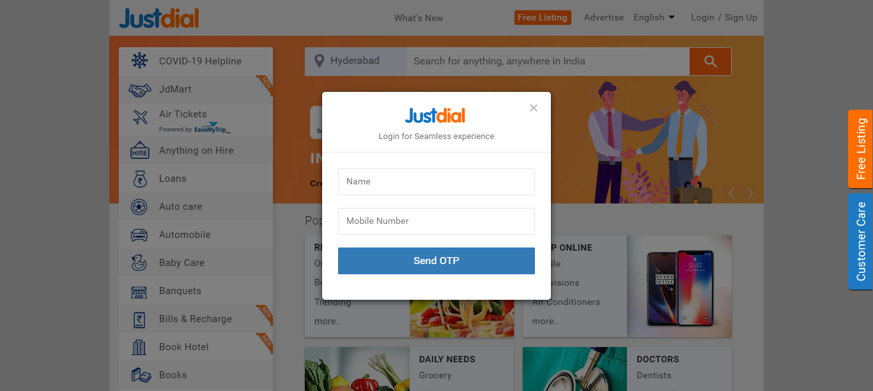
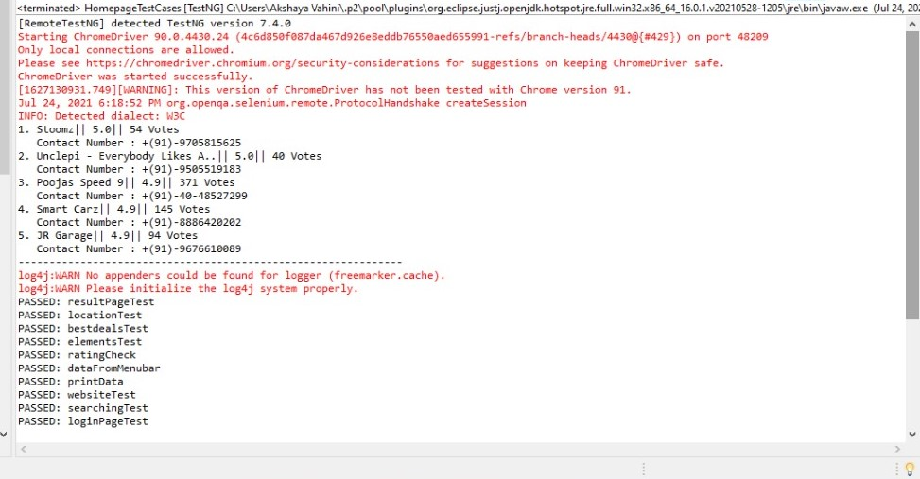

Slide 32


Slide 33
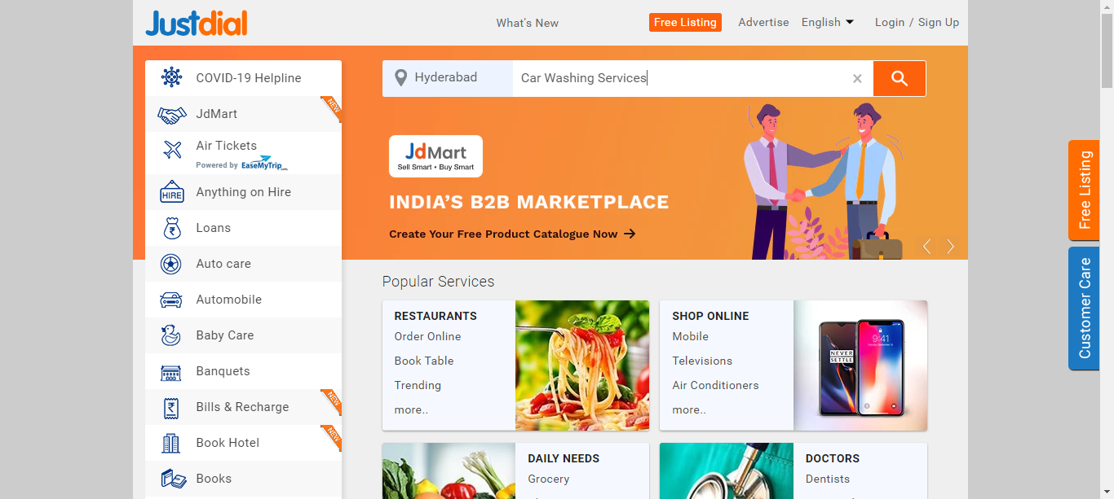

Slide 34
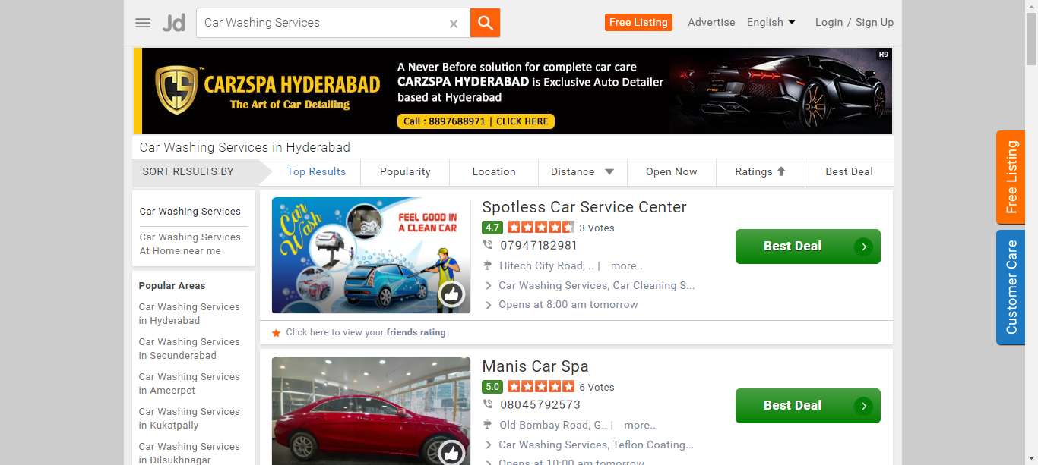

Slide 35
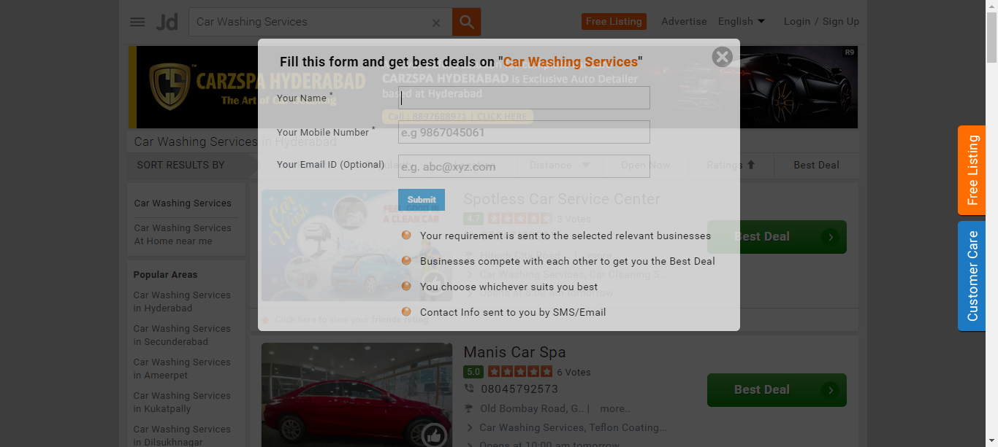

Slide 36
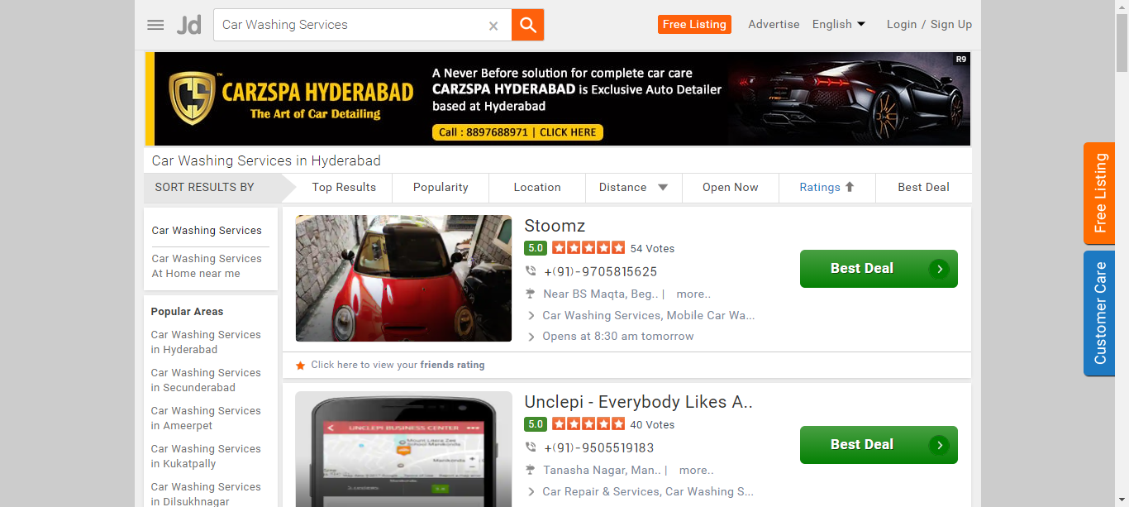

Slide 37
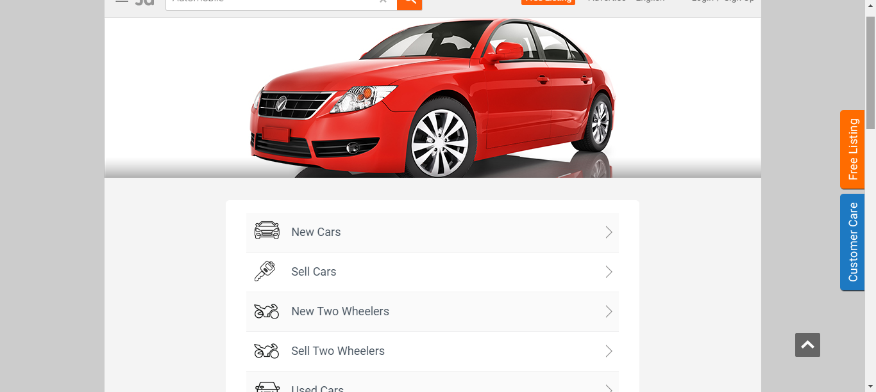

Slide 38
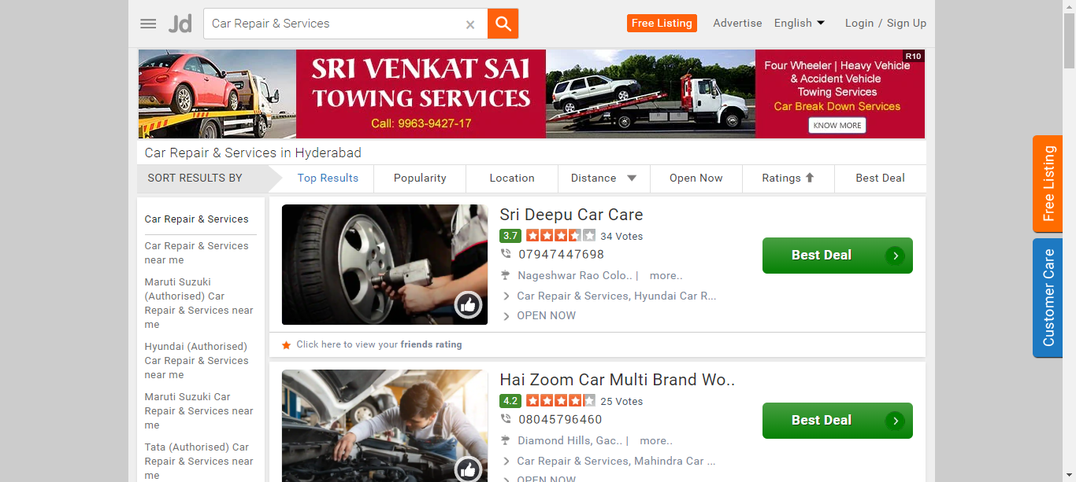

Slide 39
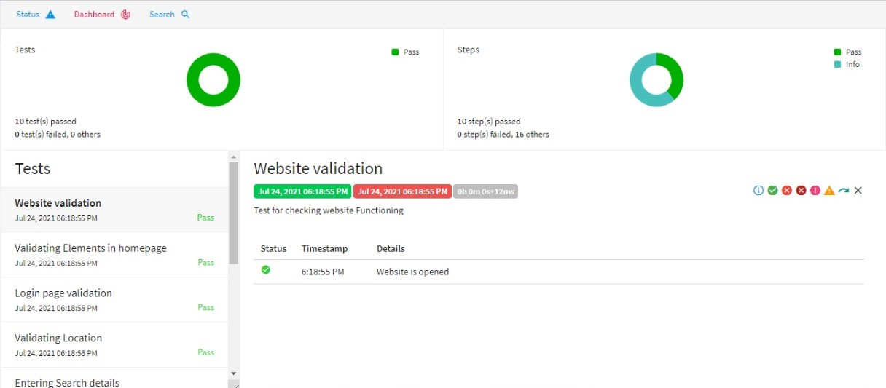

Slide 40
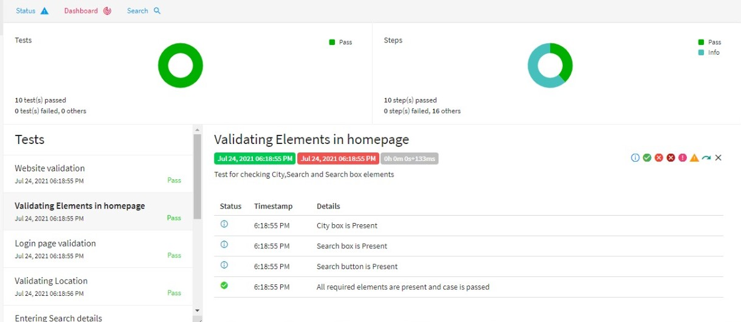

Slide 41
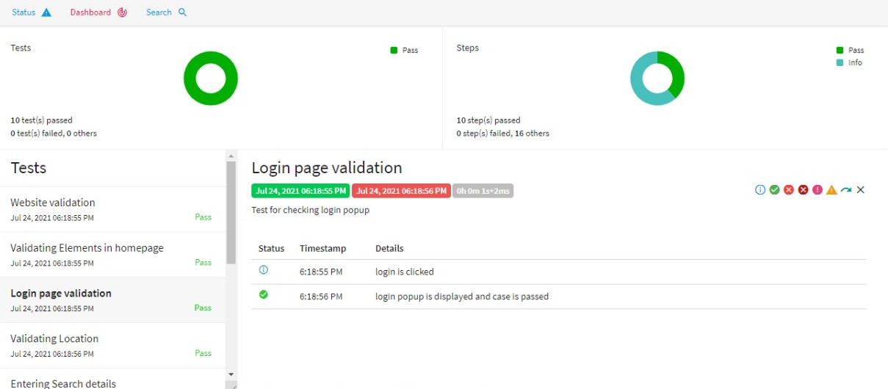

Slide 42
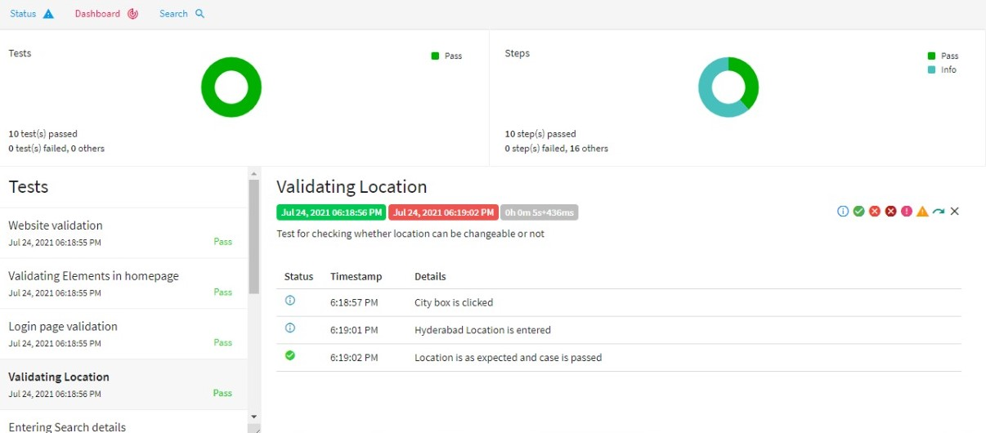

Slide 43
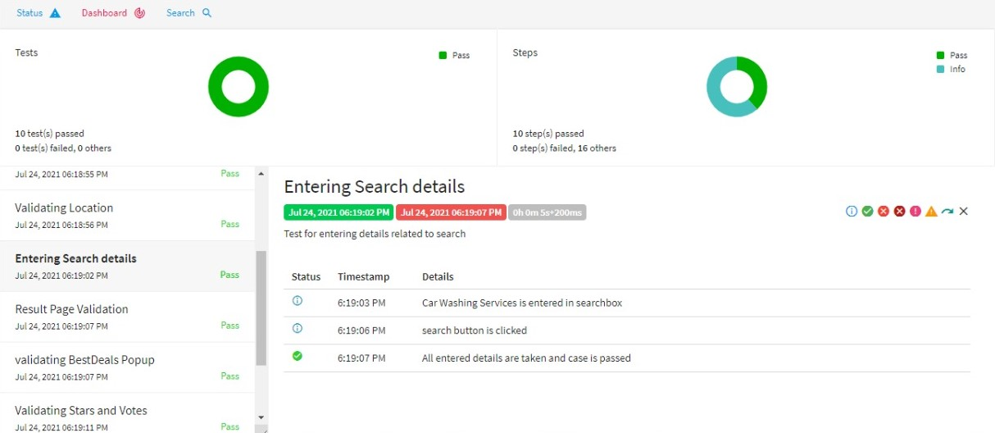

Slide 44
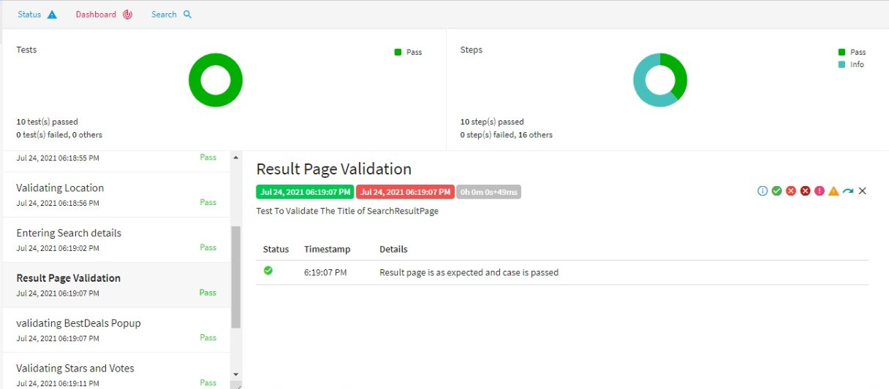

Slide 45
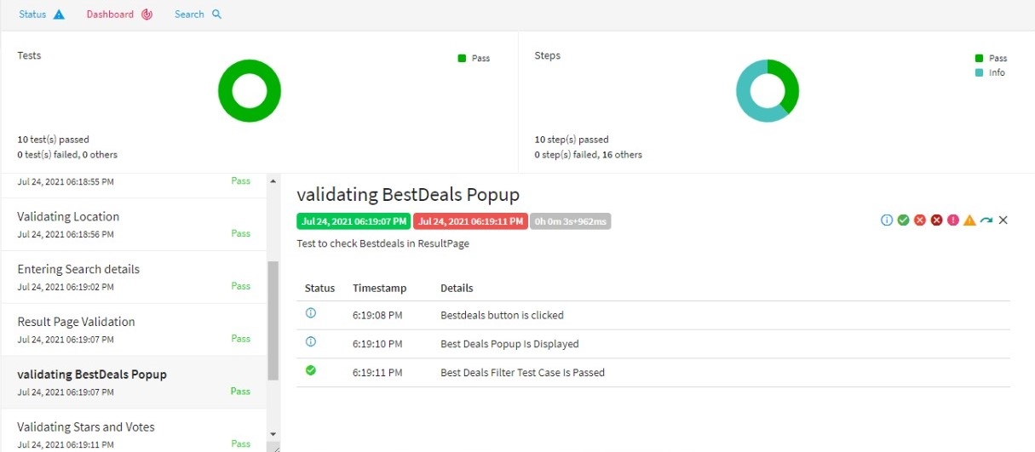

Slide 46
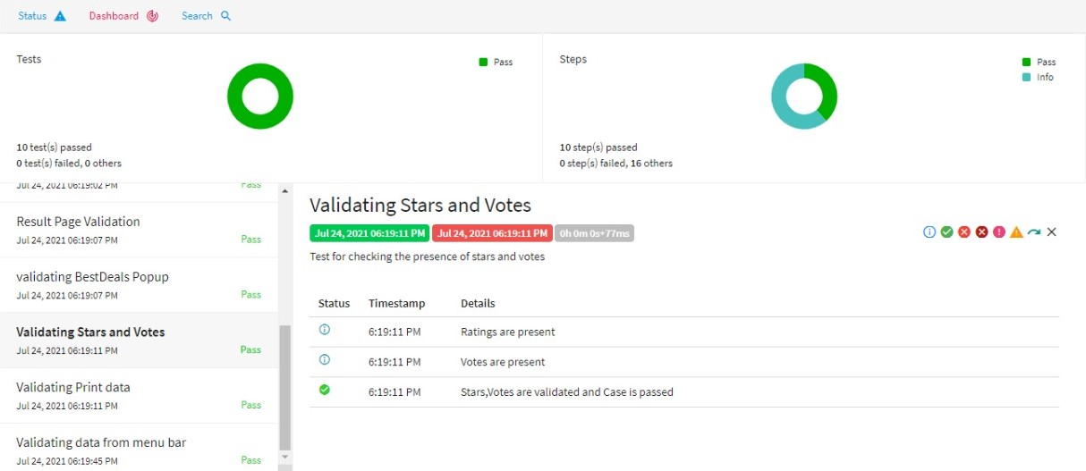

Slide 47
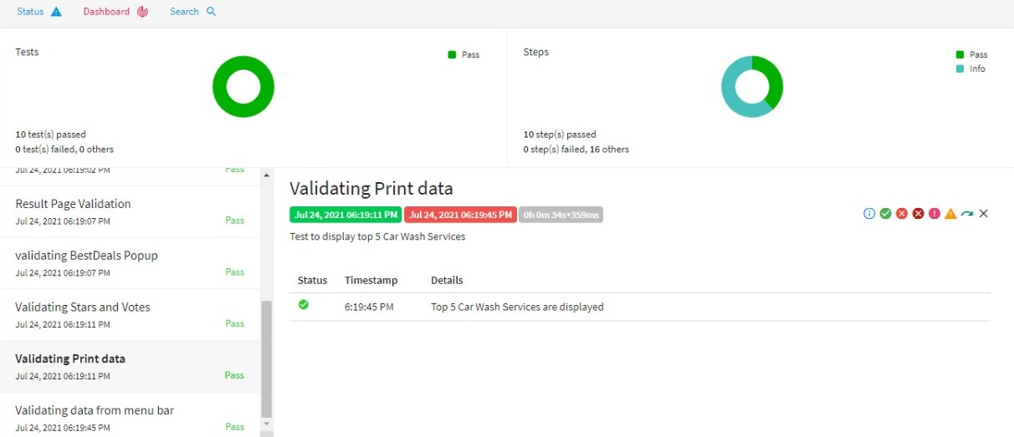

Slide 48
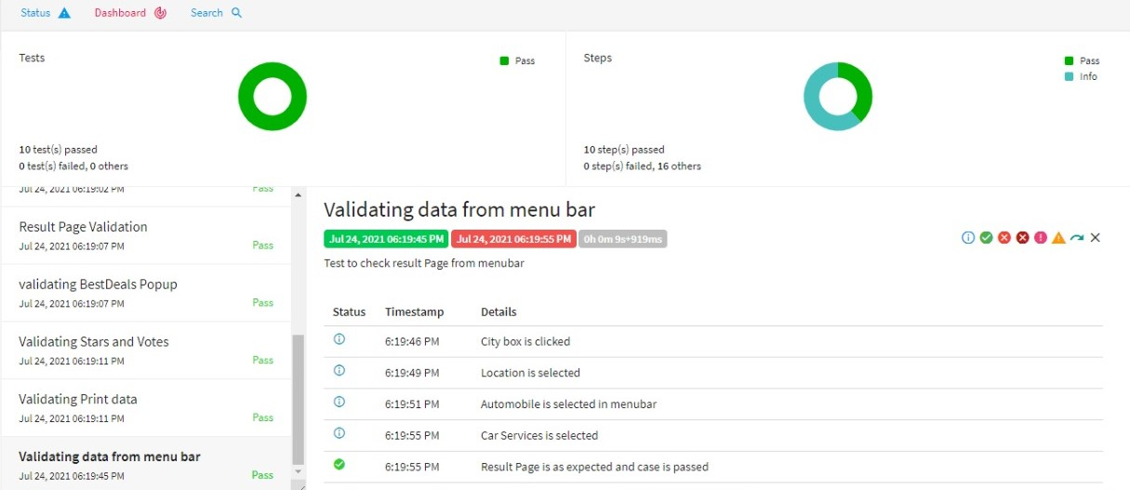

Slide 49
JENKINS
Jenkins is a free and open source automation server.
It helps to automate the parts of software development related to building , testing, and deploying, facilitating continuous integration and continuous delivary.

Slide 50
Name | EmpID | Work
Sri Harshitha Gaddamanugu | 935048 | FreelistingTestCases
Akshaya Vahini Surepally | 935099 | HomePageTestCases
Bhaskar Pedda Narsappa | 935917 | HomePage
B Sai Kumar Yadav | 935918 | FitnessTestCases
Rajesh Chakali | 935720 | Fitness

Slide 51
CONCLUSION
We worked on Justdial website, where we can find local services available along with their contact information.
We used selenium for automation and testing for execution of test-cases.
All the three test cases were passed successfully after testing with testing.
Extent report was generated which shows the logs of all the test cases passed.
We also implemented the Jenkins

Slide 52


